Slide 1
CSC 112: Computer Operating Systems Lecture 4 Deadlocks Exercises
Department of Computer Science,
Hofstra University
Acknowledgement: Lecture slides based on UC Berkeley CS 162: Operating Systems and System Programming

Slide 2
Quiz: Deadlocks II
Is there a possible deadlock?
Yes, there is a deadlock. Consider the following interleaving:
Thread T1 executes L1.wait(); no blocking
Thread T2 executes L3.wait(); no blocking
Thread T3 executes L2.wait(); no blocking
Now there is a circular wait condition:
T1 waiting for L2 (held by T3) → T2 waiting for L1 (held by T1) → T3 waiting for L3 (held by T2).
Solution: each thread should acquire locks in the same order, say, L1, L2, L3.
1 Semaphore L1=1, L2=1, L3=1;
2
// Thread T1:
L1.wait();
L2.wait();
// critical section requiring L1 and L2 locked.
L2.post();
L1.post();
9
// Thread T2:
L3.wait();
L1.wait();
// critical section requiring L3 and L1 locked.
L1.post();
L3.post();
16
// Thread T3:
L2.wait();
L3.wait();
// critical section requiring L2 and L3 locked.
L3.post();
L2.post();
T1
T2
T3
L1
L2
L3
A RAG with a deadlock

Slide 3
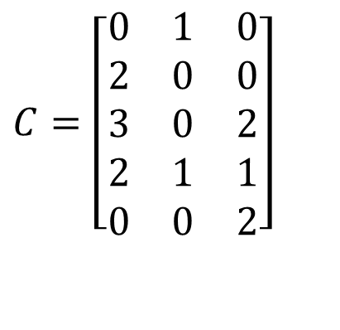
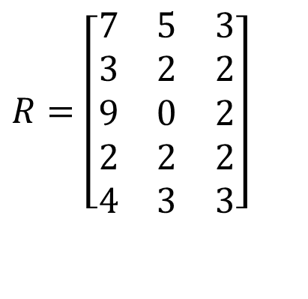

Quiz: Banker’s Algorithm I
4 processes P1 through P5; 3 resource types R1, R2, R3 with 7, 3, 6 instances each.
Run Banker’s algorithm to check if the current state is safe. If yes, give a safe sequence of process completions and fill in the table with the sequence of process completions without deadlock, and available resources after the completion of each process.
(You will be graded on “Need matrix”, and “Available resources after completion of each process”.)
Max
Allocation
$$R=\left[\begin{matrix}7 & 5 & 3 \\ 3 & 2 & 2 \\ 9 & 0 & 2 \\ 2 & 2 & 2 \\ 4 & 3 & 3\end{matrix}\right]$$
$$C=\left[\begin{matrix}0 & 1 & 0 \\ 2 & 0 & 0 \\ 3 & 0 & 2 \\ 2 & 1 & 1 \\ 0 & 0 & 2\end{matrix}\right]$$
Total
Available resources after completion of each process
$$E=\left[7\begin{matrix} & 3 & 6\end{matrix}\right]$$
 | R1 | R2 | R3
Init

Slide 4

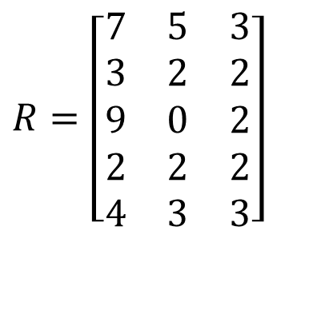


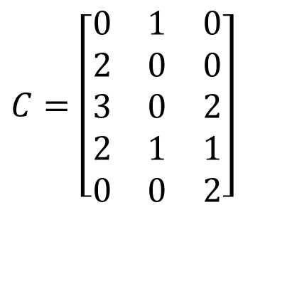
Quiz Solution: Banker’s Algorithm I
First compute the Need matrix as Max – Allocation, and Available vector A.
The state is not safe, the execution sequence P4, P2 leads to a deadlock state, where none of the remaining processes P1, P3, P5 can finish.
Available resources after completion of each process
Max
Allocation
Need
$$R=\left[\begin{matrix}7 & 5 & 3 \\ 3 & 2 & 2 \\ 9 & 0 & 2 \\ 2 & 2 & 2 \\ 4 & 3 & 3\end{matrix}\right]$$
$$C=\left[\begin{matrix}0 & 1 & 0 \\ 2 & 0 & 0 \\ 3 & 0 & 2 \\ 2 & 1 & 1 \\ 0 & 0 & 2\end{matrix}\right]$$
$$R−C=\left[\begin{matrix}7 & 4 & 3 \\ 1 & 2 & 2 \\ 6 & 0 & 0 \\ 0 & 1 & 1 \\ 4 & 3 & 1\end{matrix}\right]$$
 | R1 | R2 | R3
Init | 0 | 1 | 1
P4 | 2 | 2 | 2
P2 | 4 | 2 | 2
 | Deadlock
Total
Available
$$E=\left[7\begin{matrix} & 3 & 6\end{matrix}\right]$$
$$A=\left[0\begin{matrix} & 1 & 1\end{matrix}\right]$$
Your task

Slide 5

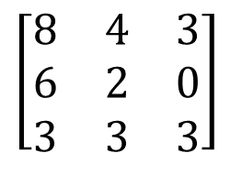
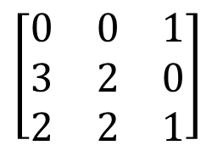
Quiz: Banker’s algorithm II
4 processes P1, P2, P3; 3 resource types R1, R2, R3 with 8, 6, 4 instances each.
1) Run Banker’s algorithm to check if the current state is safe. If yes, give a safe sequence of process completions and fill in the table with the sequence of process completions without deadlock, and available resources after the completion of each process.
2) Starting from the initial state, if P1 makes request for 2 more instances of resource 3, should we grant it?
3) Starting from the initial state, if P2 makes request for 2 more instances of resource 1, should we grant it?
Max
Allocation
$$\left[\begin{matrix}8 & 4 & 3 \\ 6 & 2 & 0 \\ 3 & 3 & 3\end{matrix}\right]$$
$$\left[\begin{matrix}0 & 0 & 1 \\ 3 & 2 & 0 \\ 2 & 2 & 1\end{matrix}\right]$$
Total
$$E=\left[8\begin{matrix} & 6 & 4\end{matrix}\right]$$
Available resources after completion of each process
 | R1 | R2 | R3
Init

Slide 6

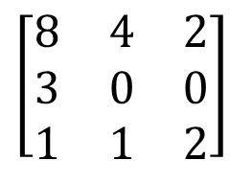
Quiz Solution: Banker’s algorithm II
The initial state is safe, with safe sequences of P2, P3, P1 or P2, P2, P1
Max
Allocation
Need
$$\left[\begin{matrix}8 & 4 & 3 \\ 6 & 2 & 0 \\ 3 & 3 & 3\end{matrix}\right]$$
$$\left[\begin{matrix}0 & 0 & 1 \\ 3 & 2 & 0 \\ 2 & 2 & 1\end{matrix}\right]$$
$$\left[\begin{matrix}8 & 4 & 2 \\ 3 & 0 & 0 \\ 1 & 1 & 2\end{matrix}\right]$$
Total
Available
$$E=\left[8\begin{matrix} & 6 & 4\end{matrix}\right]$$
$$E=\left[3\begin{matrix} & 2 & 2\end{matrix}\right]$$
Available resources after completion of each process
Available resources after completion of each process
 | R1 | R2 | R3
Init | 3 | 2 | 2
P2 | 6 | 4 | 2
P3 | 8 | 6 | 3
P1 | 8 | 6 | 4
 | R1 | R2 | R3
Init | 3 | 2 | 2
P3 | 5 | 4 | 3
P2 | 8 | 6 | 3
P1 | 8 | 6 | 4
Or

Slide 7

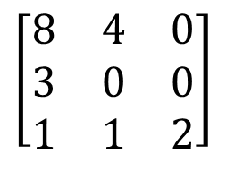
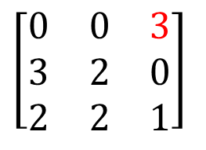
Quiz Solution: Banker’s algorithm II
Starting from the initial state, if P1 makes request for 2 more instances of resource 3, then we calculate the state of the system if this request is fulfilled.
The state is unsafe, so we deny this request.
Max
Allocation
Need
$$\left[\begin{matrix}8 & 4 & 3 \\ 6 & 2 & 0 \\ 3 & 3 & 3\end{matrix}\right]$$
$$\left[\begin{matrix}0 & 0 & 3 \\ 3 & 2 & 0 \\ 2 & 2 & 1\end{matrix}\right]$$
$$\left[\begin{matrix}8 & 4 & 0 \\ 3 & 0 & 0 \\ 1 & 1 & 2\end{matrix}\right]$$
Total
Available
$$E=\left[8\begin{matrix} & 6 & 4\end{matrix}\right]$$
$$E=\left[3\begin{matrix} & 2 & 0\end{matrix}\right]$$
Available resources after completion of each process
 | R1 | R2 | R3
Init | 3 | 2 | 0
P2 | 6 | 4 | 0
 | Deadlocked

Slide 8

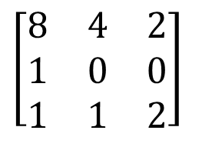
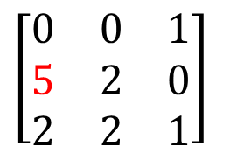
Quiz Solution: Banker’s algorithm II
Starting from the initial state, if P2 makes request for 2 more instances of resource 1, then we calculate the state of the system if this request is fulfilled.
The state is safe, with safe sequences of P2, P3, P1 or P2, P2, P1, so we can grant this request.
Max
Allocation
Need
$$\left[\begin{matrix}8 & 4 & 3 \\ 6 & 2 & 0 \\ 3 & 3 & 3\end{matrix}\right]$$
$$\left[\begin{matrix}0 & 0 & 1 \\ 5 & 2 & 0 \\ 2 & 2 & 1\end{matrix}\right]$$
$$\left[\begin{matrix}8 & 4 & 2 \\ 1 & 0 & 0 \\ 1 & 1 & 2\end{matrix}\right]$$
Total
Available
$$E=\left[8\begin{matrix} & 6 & 4\end{matrix}\right]$$
$$E=\left[1\begin{matrix} & 2 & 2\end{matrix}\right]$$
Available resources after completion of each process
Available resources after completion of each process
 | R1 | R2 | R3
Init | 1 | 2 | 2
P2 | 6 | 4 | 2
P3 | 8 | 6 | 3
P1 | 8 | 6 | 4
 | R1 | R2 | R3
Init | 1 | 2 | 2
P3 | 3 | 4 | 3
P2 | 8 | 6 | 3
P1 | 8 | 6 | 4
Or

Slide 9

Banker’s Algorithm: 4 philosophers each holding his left fork
Max
Allocation
Need
0
1
0
1
$$R−C$$
0
1
0
1
1
1
Available resources after completion of each process
Total
Available
 | R1 | R2 | R3 | R4 | R5
 | 0 | 0 | 0 | 0 | 1
Suppose we have 5 philosophers P1-P5, and 5 forks R1-R5; philosopher Pi has left fork Ri, and right fork R(i+1)%5. Philosophers P1-P4 each is holding his left fork.
Run Banker’s algorithm to check if the current state is safe. If yes, give a safe sequence of process completions and fill in the table with the sequence of process completions without deadlock, and available resources after the completion of each process.

Slide 10
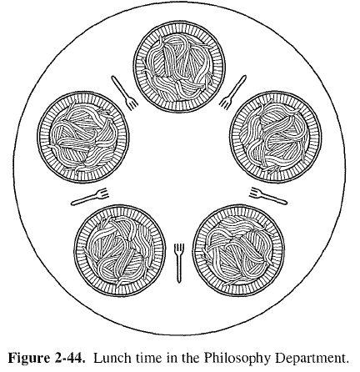
Banker’s Algorithm: 4 philosophers each holding his left fork ANS
Yes, current state is safe, and the only safe sequence is P4, P3, P2, P1, P5
P4
R5
R4
Available resources after completion of each process
P5
P3
 | R1 | R2 | R3 | R4 | R5
 | 0 | 0 | 0 | 0 | 1
P4 | 0 | 0 | 0 | 1 | 1
P3 | 0 | 0 | 1 | 1 | 1
P2 | 0 | 1 | 1 | 1 | 1
P1 | 1 | 1 | 1 | 1 | 1
P5 | 1 | 1 | 1 | 1 | 1
R1
R3
P1
R2
P2
Notes:
https://people.eecs.berkeley.edu/~kubitron/courses/cs162-F07/exams/fa07mt1-solutions.pdf
The lawyers are so busy talking that they can only grab one chopstick at a time. Design a deadlock-free algorithm using monitors and Bankers algorithm.

Slide 11
Banker’s Algorithm: 5 philosophers each holding his left fork
Max
Allocation
Need
0
1
0
1
0
1
0
1
1
Total
Available
Run Banker’s algorithm to check if the current state is safe.
ANS: It is not safe, as no process can run to completion based on Need matrix and Available vector.

